Slide 1
Healthy Fast Food

Slide 2
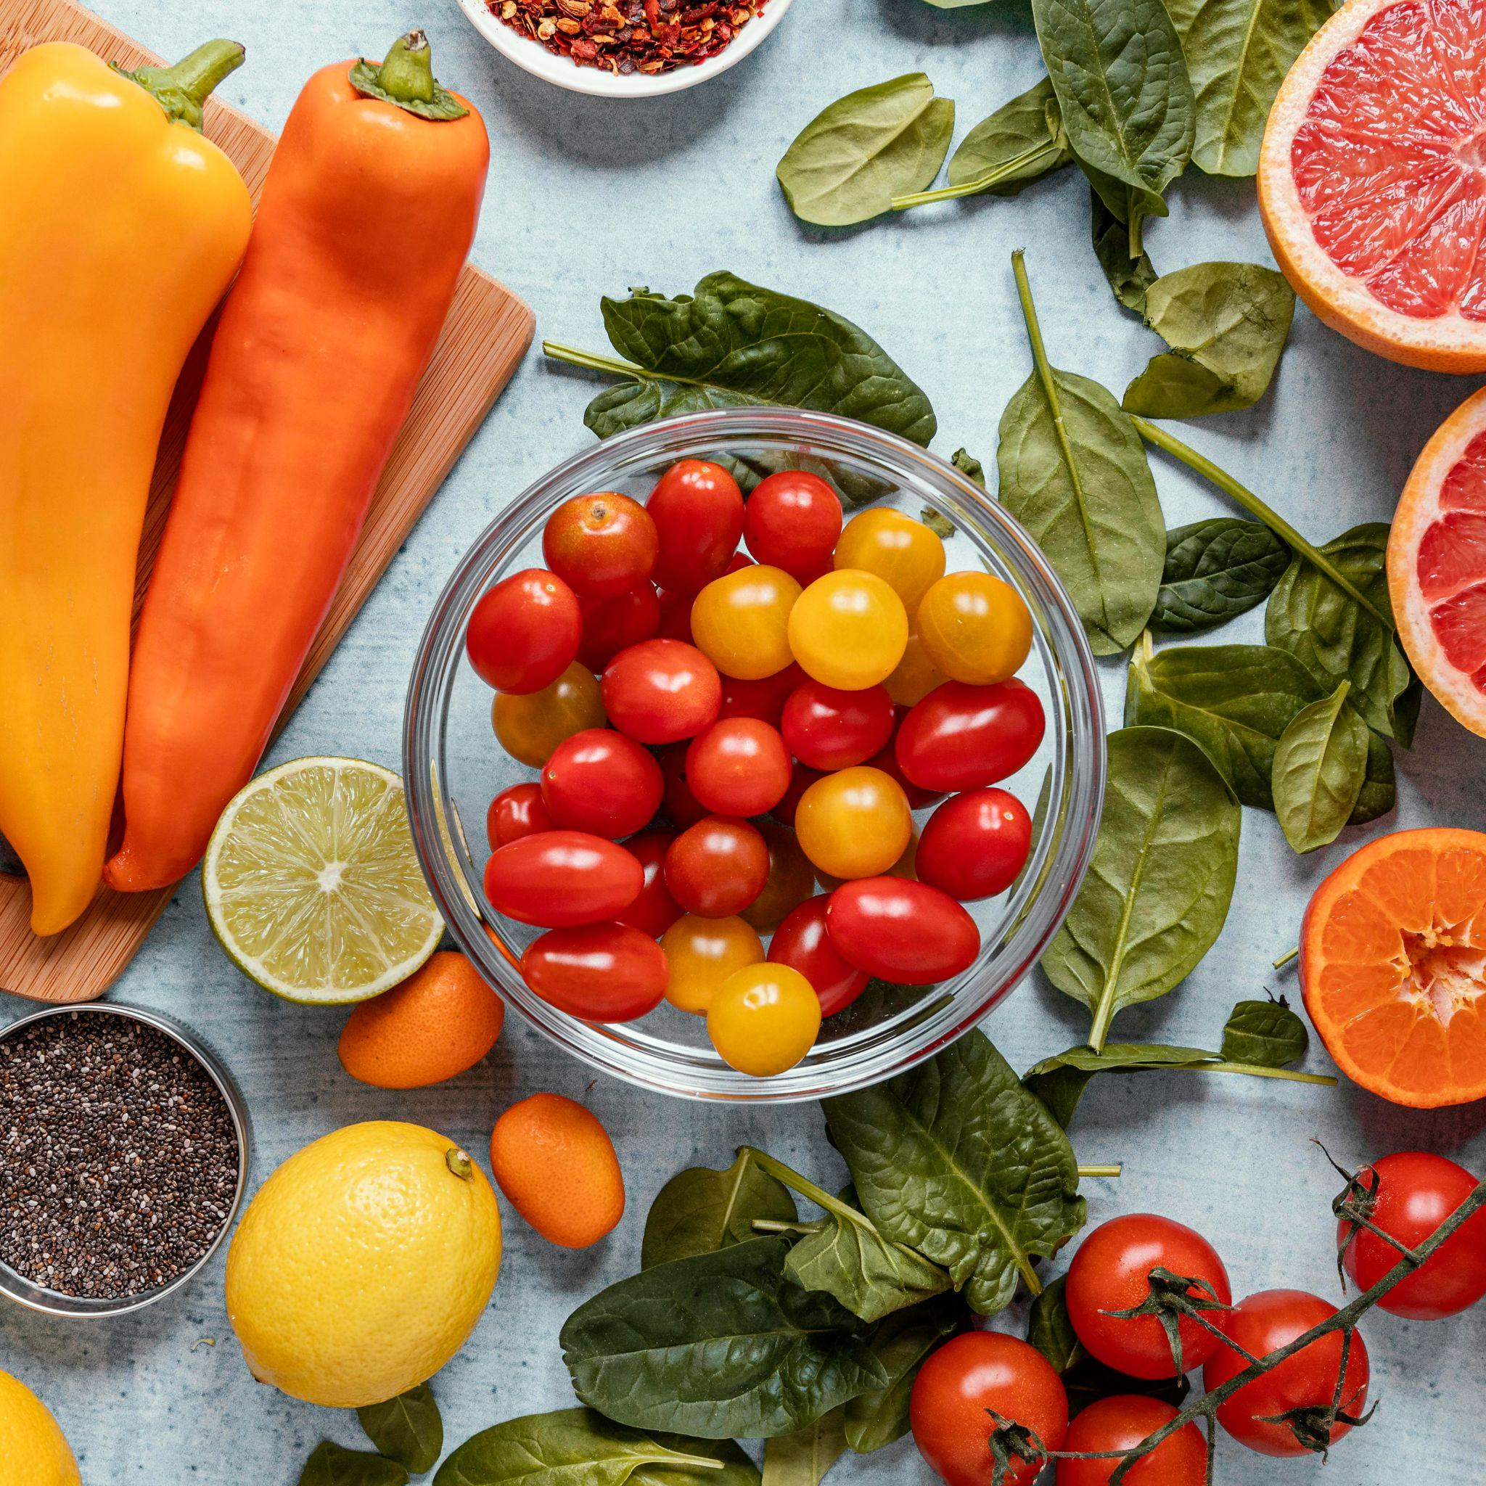
Finding a healthy, well-balanced meal in most fast food restaurants can be a challenge.
The following tips and menu recommendations can help you stay on track.

Slide 3

1
Try to keep your meal at about 500 calories or less. Avoid supersized or jumbo meals.

Slide 4
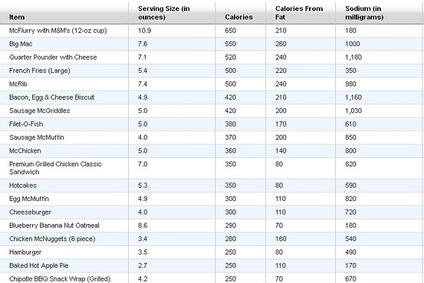
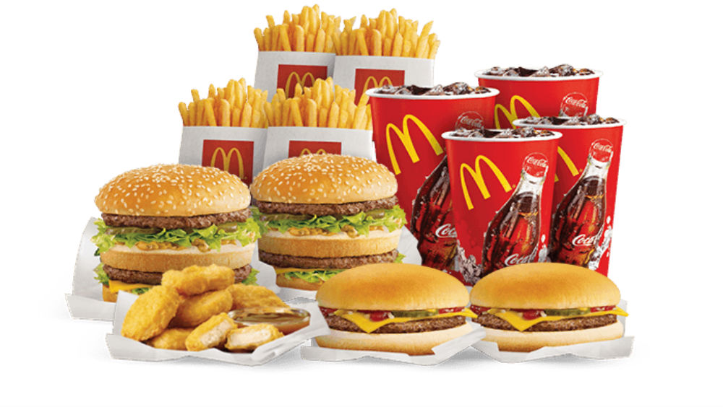
Most chains post nutritional info both on their websites and at the franchise location.

Slide 5

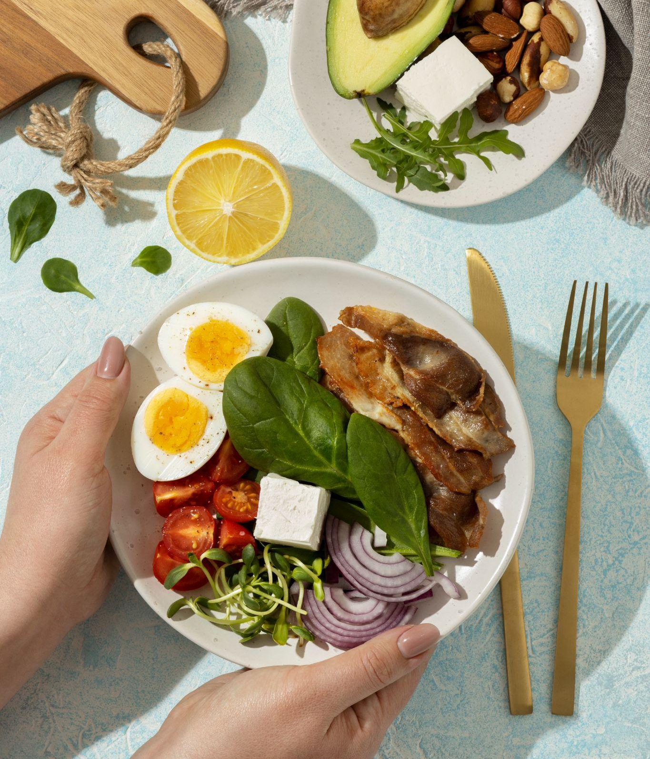
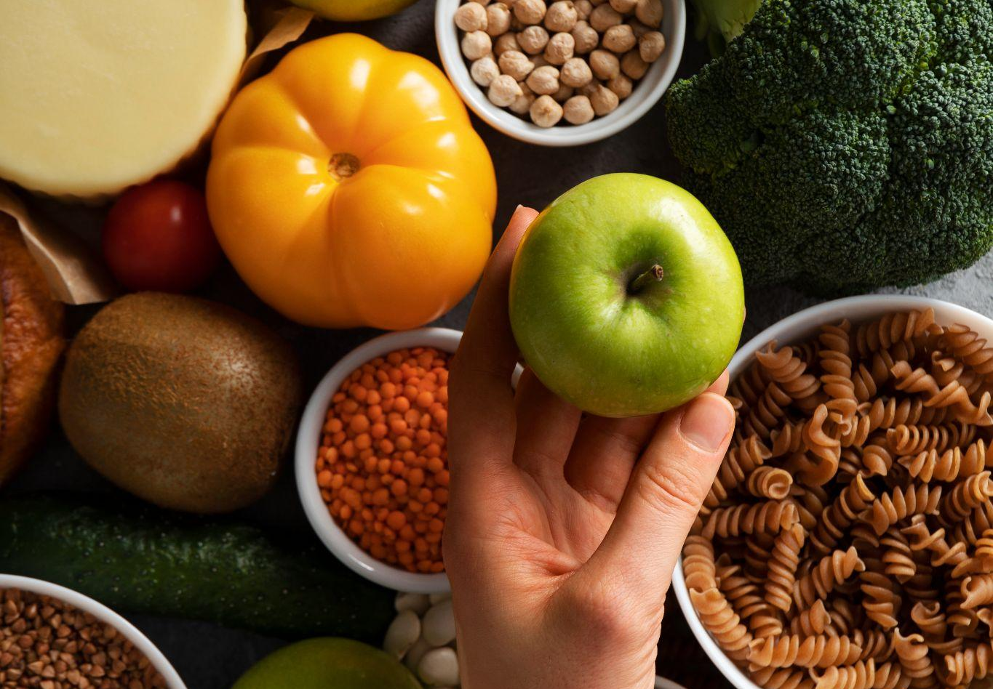
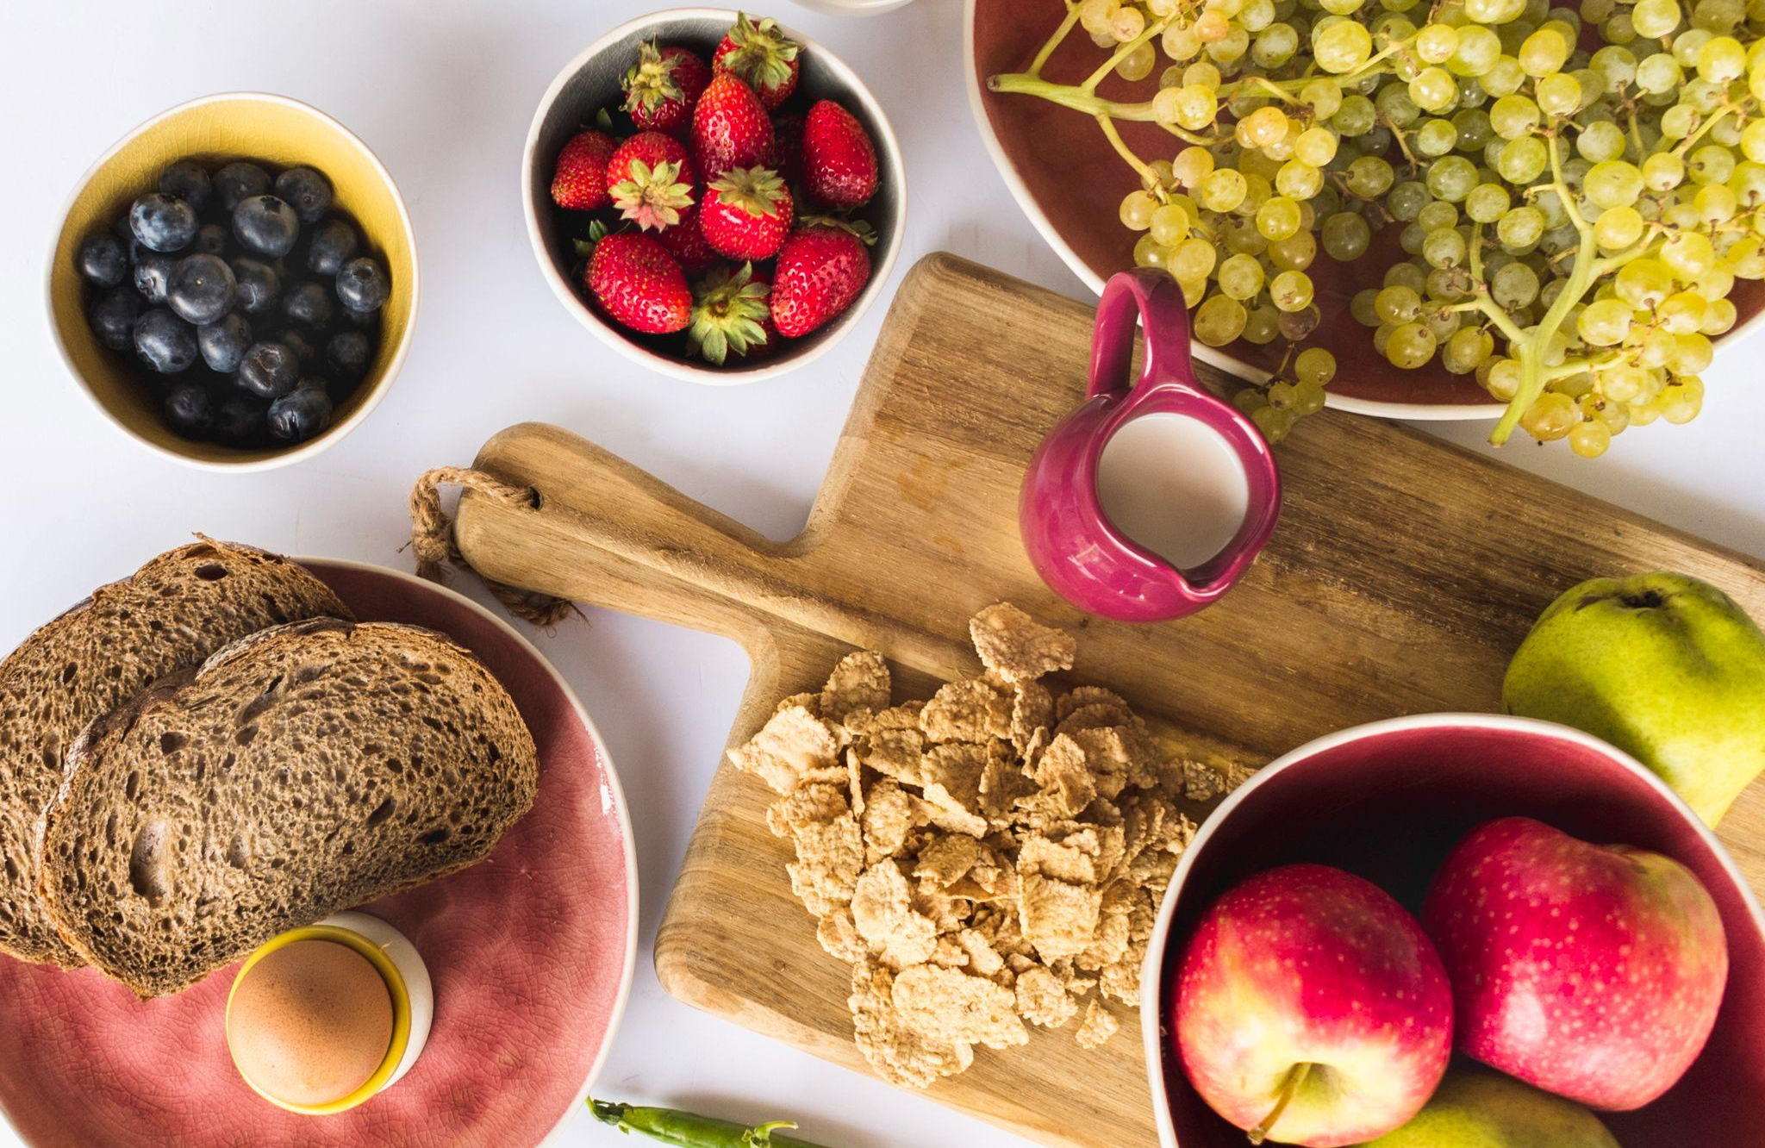
Photo showcase
This photo showcase is a collection of stunning images, each capturing a unique moment in time. Let them inspire you!

Slide 6
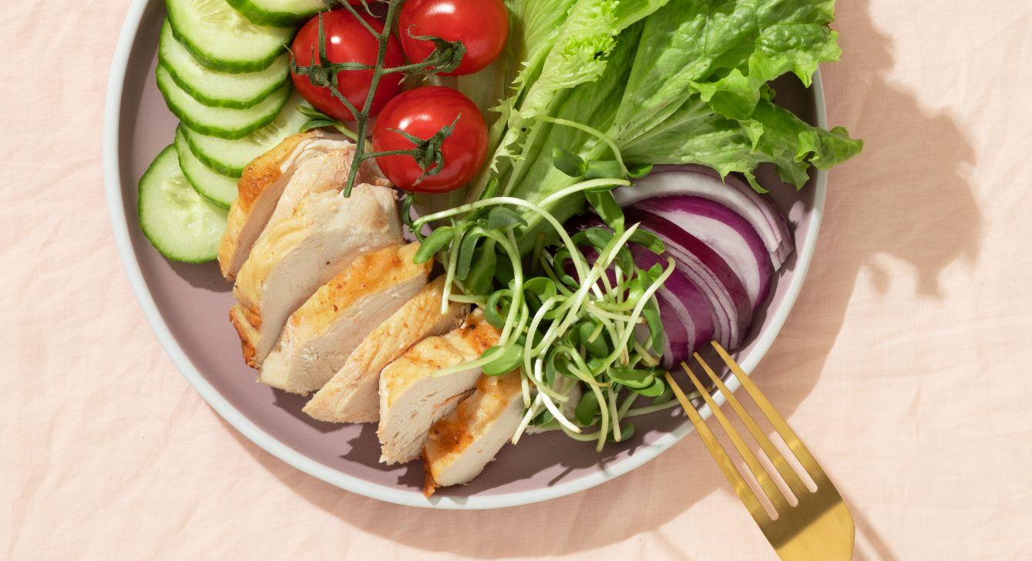

My best work
“As an artist, it's my job to capture the beauty, joy and emotion of the world around me. I strive to create something unique in each piece, combining technique and detail”

Slide 7

Opt for foods that are lower in fat and higher in protein and fiber. And steer clear of all items that contain trans fats.

Slide 8
Stack your meal with as many vegetables as you can

Slide 9
Opt for unsweetened tea or stick with water instead of soda

Slide 10
Thanks!

